Slide 1
Group 1 Jolinda Connie Pam Jim
Air BnB

Slide 2
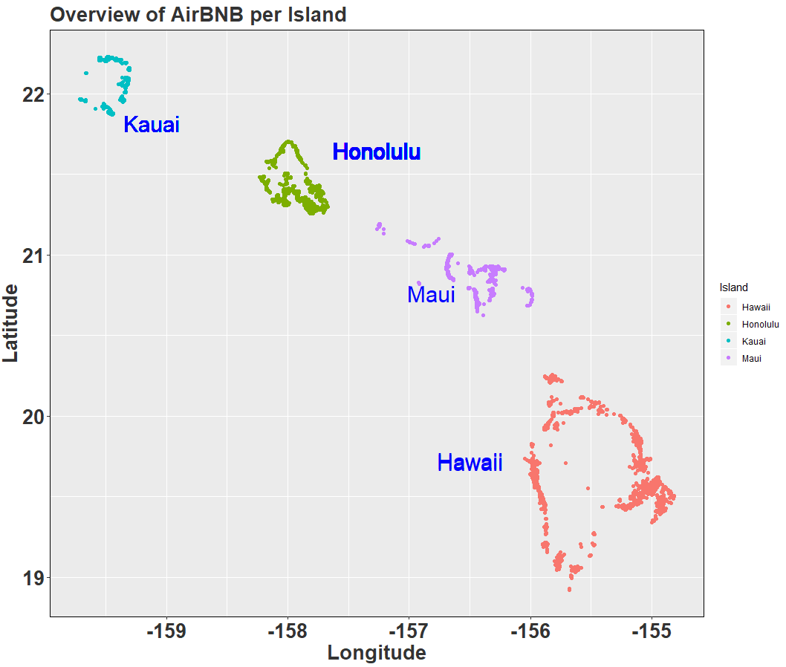
Overview
4 Islands
17204 AirBnB’s

Slide 3
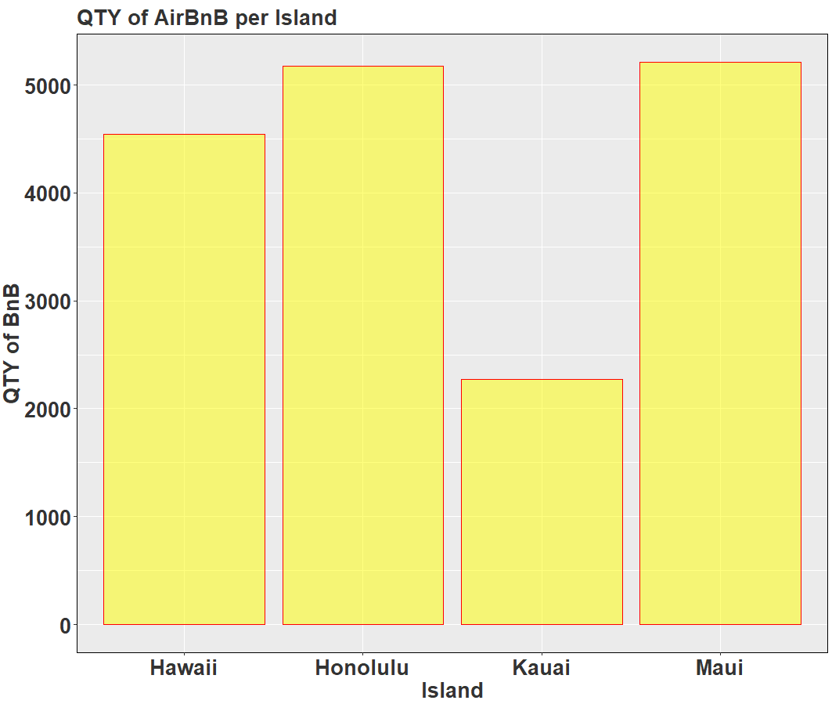
Qty per Island
Kaui has fewest
Who has the great
hosts

Slide 4
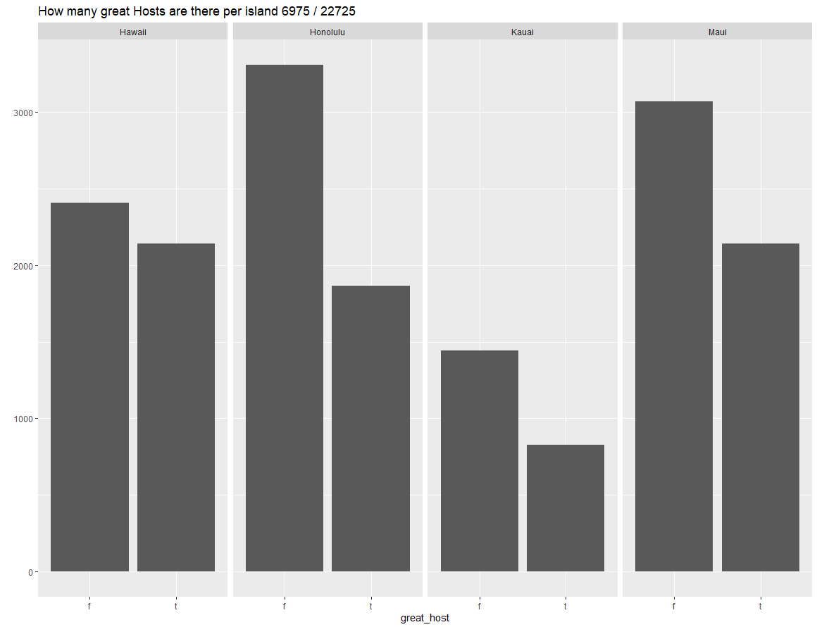
Great Hosts
Hawaii is even

Slide 5
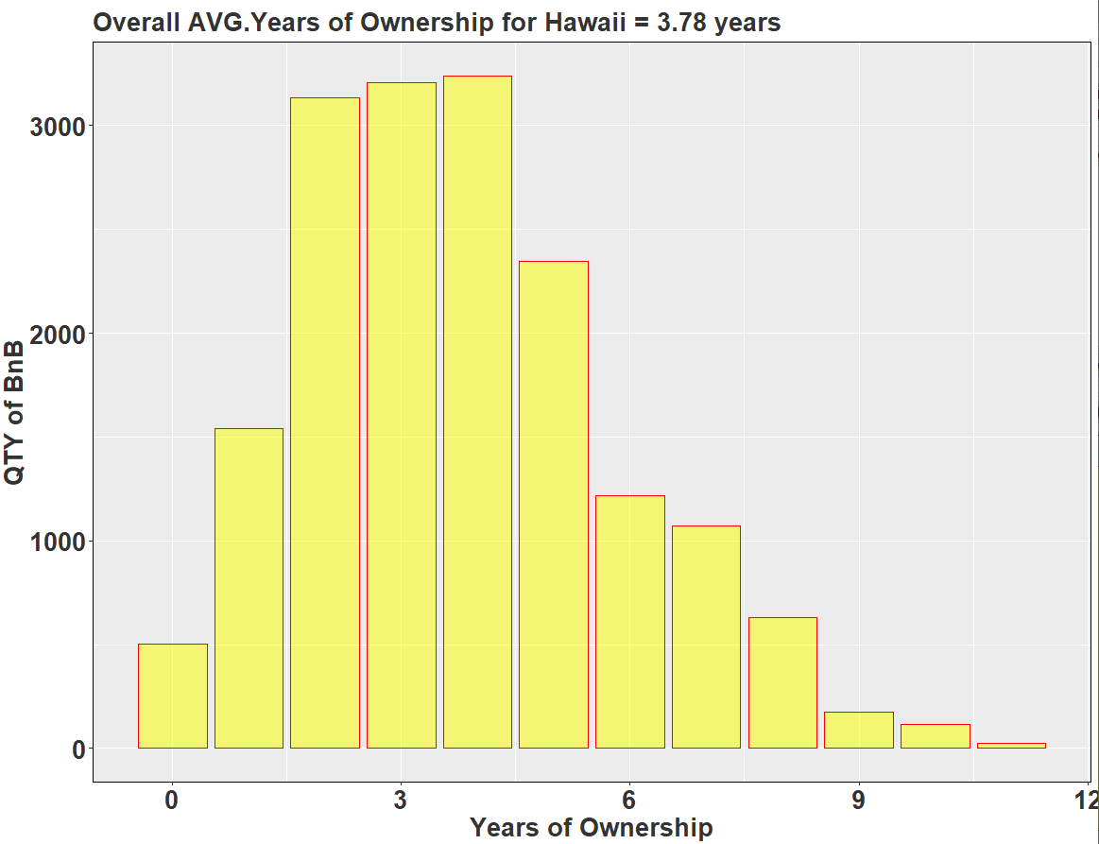
Years of Ownership
Avg. 3.78
Considering all
islands

Slide 6
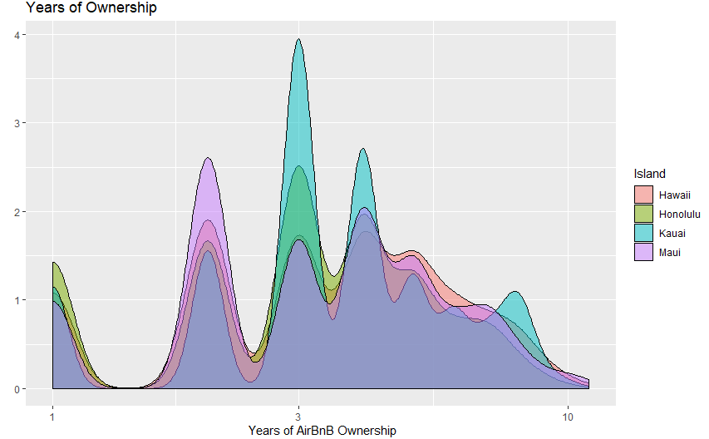
Years of Ownership

Slide 7
Price

Slide 8
Break it down by Hawaii

